Slide 1
IPL ANALYSIS - RCB IPL STRATEGY
TEJAS K R

Slide 2
ABOUT IPL
ABOUT RCB
The IPL is a premier Twenty20 cricket league in India, renowned for its high-energy matches, city-based teams, and global player auction, which has popularized shorter formats of cricket and influenced leagues around the world.
It significantly drives the economy through sponsorships, broadcasting rights, and tourism, generating substantial financial benefits.
The Royal Challengers Bangalore (RCB), established in 2008 and based in Bangalore, is known for its star players like Virat Kohli and AB de Villiers, and plays its home matches at M. Chinnaswamy Stadium.
Despite not winning an IPL title yet, RCB is renowned for high-scoring matches and record-breaking performances, making it one of the most popular and commercially successful teams in the league.

Slide 3
PROBLEM STATEMENT
You are hired as a sports data analyst by RCB, where the team is looking for top-performing and reliable players to win tournaments, considering both on-field performance and value for money in the mega player auction of 2017.
Your task is to come up with strategies/suggestions regarding selecting the best-performing players and optimizing player auction investments.

Slide 4
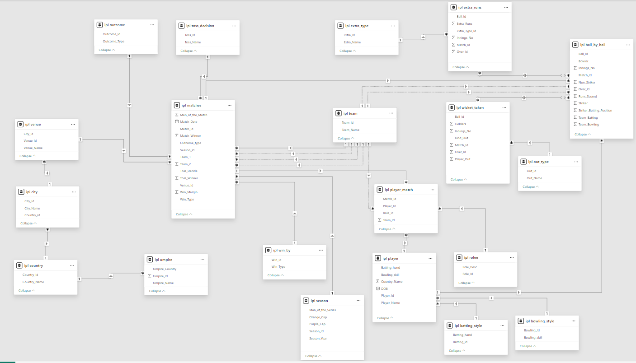
Database Schema

Slide 5
DATABASE SCHEMA OVERVIEW
Ball by Ball
Batting Style
Bowling Style
City
Extra Type
Season
Win By
Outcome
Out Type
Role
Team
Umpire
Toss Decision
Player

Slide 6
Methodology
Data Cleaning: Used a REPLACE statement to update the team name correctly from Delhi Capitals to Delhi Daredevils.
Data Aggregation: Used various aggregation functions such as SUM(), AVG(), COUNT(), etc. To aggregate data and get a meaningful summary.
Data Manipulation: Used various JOINS and SUB-QUERIES to combine different tables and manipulate the data for easier analysis.
Data Measurement: Measured the performance of various players using functions like LIMIT, DENSE_RANK(), ROW_NUMBER().
Data Visualisation: Visualized the output to summarise the data, gain meaningful insights and identify any trends.

Slide 7
PLAYERS WITH HIGH STRIKE RATE
Strike rate is the rate at which the batsman scores runs.
We can see that KH Pandya has the highest strike rate from the past 4 seasons with an impressive 186.71
Followed by SN Khan and AB de Villiers with 171.84 and 164.27 strike rate respectively.

Slide 8
BEST BATTING AVERAGE
Consistent players: V Kohli (Avg 39.24) and DA Warner (Avg 37.87) deliver high volume and reliability across 60+ innings.
Impact Players: LMP Simmons tops the chart (Avg 42.82) with fewer innings — ideal for short-format dominance.
Mid-Tier Depth: Players like AB de Villiers, MEK Hussey, and AM Rahane (~33 Avg) offer stable middle-order options.

Slide 9
BEST BOWLING AVERAGE
Top Efficiency: DJ Bravo leads with Avg_wicket of 27 — consistent wicket-taker across formats.
Elite Strike Zone: Malinga, Starc, and Sharma average ~19.5 wickets — lethal in middle and death overs.
Depth & Value: Bowlers ranked 5–9 (Chahal to Wiese) maintain sub-20 averages — ideal for rotation and match control.

Slide 10
BOWLING STYLE ANALYSIS
Versatile Threats: Fast-medium and offbreak styles (581–651 wickets) offer balance between pace and control.
Dominant Style: Right-arm medium tops the chart with 1044 wickets — backbone of most bowling attacks.
Specialist Impact: Chinaman (49 wickets) and legbreak googly (266) show niche effectiveness — ideal for surprise and variation.

Slide 11
VERSATILE PLAYERS
Identify players who demonstrate versatility by significantly contributing with both bat and ball, making them valuable all-rounders for a team. This analysis seeks to highlight players who score consistently high in both batting and bowling metrics, providing an advantage through balanced skill sets.

Slide 12
Top All-Rounder
Player Name | Total Runs | Total Wickets | All-Rounder Notes
AD Russell | 527 | 35 | Explosive striker with consistent wickets
CH Morris | 256 | 48 | High wicket count and solid batting
MJ McClenaghan | 47 | 36 | Bowling specialist with handy runs
KK Cooper | 78 | 26 | Balanced contributor in both departments
M Morkel | 66 | 43 | Dominant bowler with useful batting
CR Brathwaite | 83 | 9 | Known for clutch performances
KH Pandya | 237 | 7 | Reliable lower-order hitter and part-time bowler
Players like AD Russell, CH Morris, and MJ McClenaghan stand out as true all-rounders, contributing heavily with both bat and ball. The chart below visualizes their dual impact spot balanced performers across the dataset

Slide 13
HOME GROUND PERFORMANCE
Winning Edge: RCB has won 52% of home matches — a slight home advantage worth leveraging.
Close Margins: 45% losses indicate inconsistent execution despite familiar conditions.
Stable Conditions: Only 3% No Results — reliable venue for strategic planning and full-match outcomes.

Slide 14
RCB’S SEASON WISE PERFORMANCE

Slide 15
COMPARISON WITH PREVIOUS SEASON
RCB Performance Breakdown
Season Transition | Runs Change | Wickets Change | Status
2013 → 2014 | ↓ 2430 → 1992 | ↓ 109 → 73 | Worse
2014 → 2015 | ↑ 1992 → 2190 | ↑ 73 → 103 | Better
2015 → 2016 | ↑ 2190 → 2859 | ↓ 103 → 99 | Mixed

Slide 16
WINS AND LOSSES OF RCB IN AN INDIVIDUAL VENUE
Strongholds: Venues like Feroz Shah Kotla and Motera show a 100% win rate, highlighting reliable grounds for success.
Balanced Venues: Eden Gardens (67%) and M Chinnaswamy Stadium (55%) reflect moderate success, combining experience with decent win percentages.
Weak Spots: Stadiums such as Chepauk and Mohali record 0% wins, signaling areas where strategies need improvement.

Slide 17
HOME VS AWAY PERFORMANCE OF RCB

Slide 18
DEFENDING vs CHASING PERFORMANCES

Slide 19
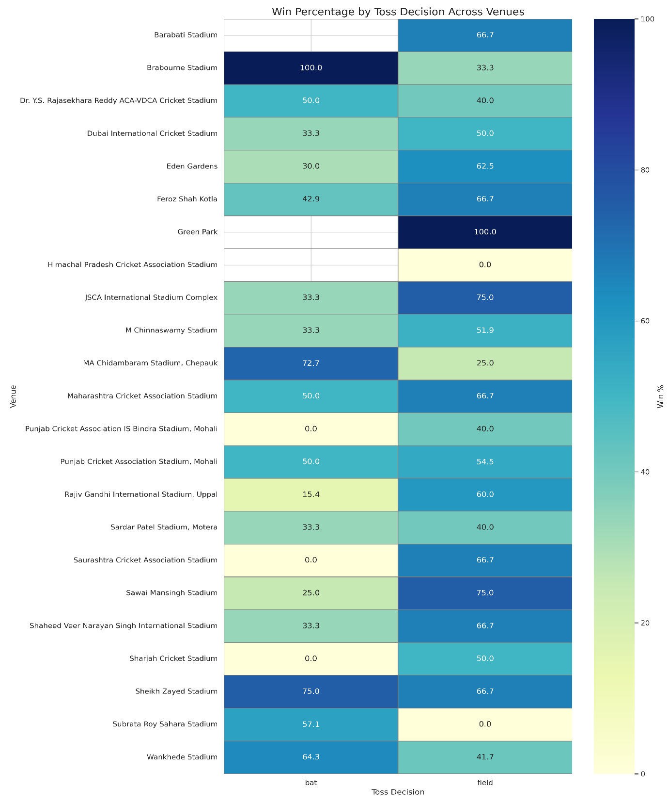
TOSS IMPACT IN DIFFERENT VENUES
Toss decisions are not universally impactful but vary significantly depending on the venue.
Teams should adopt venue-specific strategies

Slide 20
BEST BATTERS ACROSS TEAMS
Virat Kohli & David Warner – High total runs with strong strike rates → reliable top-order anchors who score fast and consistently.
AB de Villiers & Chris Gayle – Exceptional strike rates → ideal middle-order power hitters who can change games quickly.
MS Dhoni & Kieron Pollard – Balanced impact with finishing ability → perfect for lower middle order and pressure situations.

Slide 21
BEST BOWLERS ACROSS TEAMS
Dwayne Bravo & Mitchell McClenaghan – Highest wicket-takers with effective strike rates → strong impact bowlers who deliver breakthroughs consistently.
Sunil Narine & Lasith Malinga – Excellent economy with steady wickets → ideal for controlling runs in powerplay and death overs.
Ravindra Jadeja & Amit Mishra – Reliable wicket-taking spinners with low economy → perfect for middle overs and match control.

Slide 22
KEY PLAYERS
Cheteshwar Pujara & Shadab Jakati – Highest win percentage (83.33%) → consistently associated with winning matches, making them highly reliable team assets.
Tim Southee & Laxmipathy Balaji – Strong win impact (77.78%) → dependable performers who contribute effectively in pressure situations.
Mitchell Johnson & Dwayne Smith – High match involvement with solid win percentages (~76%) → key contributors to team success over multiple matches.

Slide 23
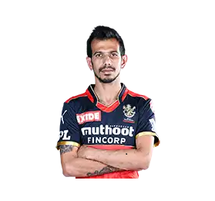
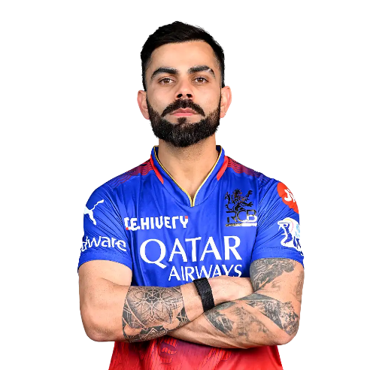
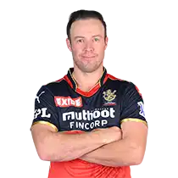
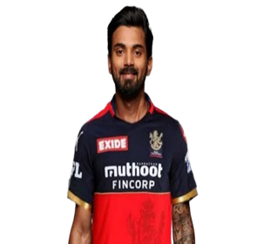
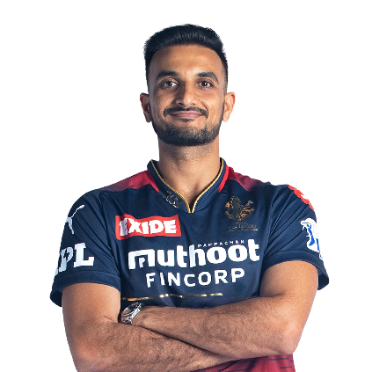
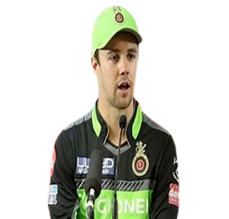
RETAINED PLAYERS AND NEW PLAYERS SELECTION
V Kohli
AB de Villiers
KL Rahul
YS Chahal
HV Patel
TM Head
Retained Players: Above 6 players retained due to good performance and fitness.
Released Players: All others released due to low performance and fitness issues.
New Additions :
Batting: M Vijay (reliable opener), DA Miller (powerful middle-order hitter).
All-Rounders: HH Pandya, RA Jadeja, DJ Bravo, JP Duminy, V Shankar, N Rana (balanced and versatile options).
Spin Bowling: Kuldeep Yadav (wrist spin), R Ashwin (experienced off-spin).
Pace Attack: MA Starc (left-arm pace), PJ Cummins (fast bowling) to strengthen pace options.
These additions aim to make RCB's squad well-rounded and balanced.

Slide 24

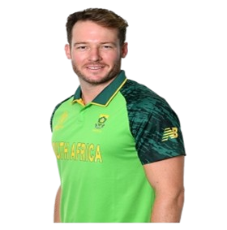
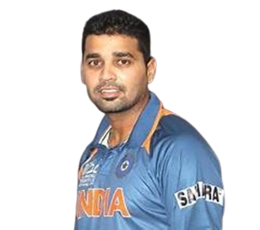
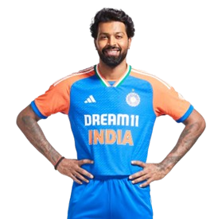
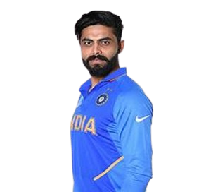
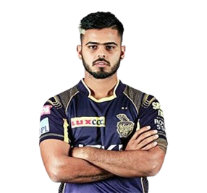
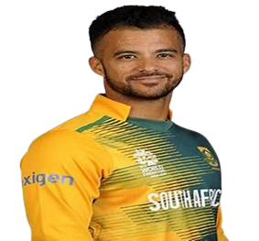
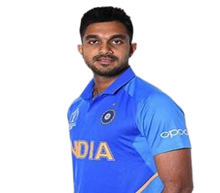

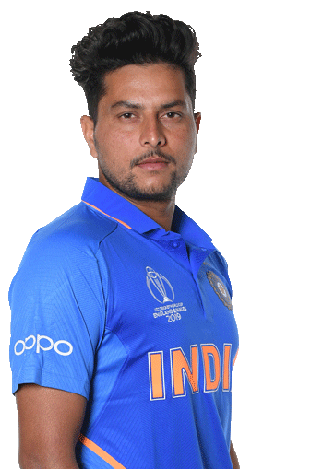
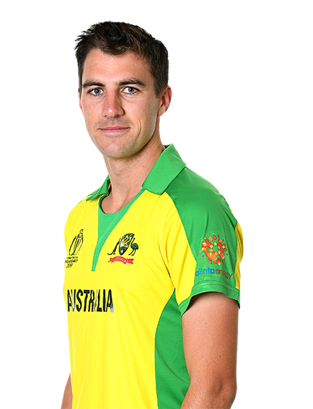
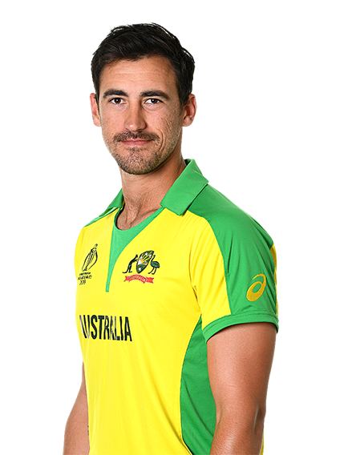

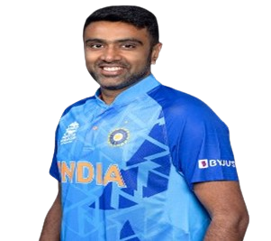
RCB SQUARD FOR IPL 10 – 2017 (AFTER AUCTION)
BATMENS
V Kohli (C)
AB de Villiers
KL Rahul(VC)(WK)
TM Head
DA Miller
M Vijay
ALLROUNDERS
HH Pandya
RA Jadeja
DJ Bravo
N Rana
JP Duminy
V Shankar
BOWLERS
MA Starc
HV Patel
YS Chahal
Kuldeep Yadav
PJ Cummins
R Ashwin

Slide 25

RCB Playing XI and Substitutes
Playing XI
V Kohli (Captain) - Provides stability and leadership.
TM Head - Brings aggression at the top.
AB de Villiers - Key finisher and middle-order strength.
KL Rahul (VC) (WK) - Flexibility in batting, anchors or accelerates as needed.
HH Pandya - Dynamic all-rounder who adds depth to both batting and bowling.
RA Jadeja - All-rounder with versatile skills.
DJ Bravo - Experienced in death-overs and finishing.
Kuldeep Yadav - Effective leg-spinner for middle overs.
MA Starc - Leading fast bowler with death-overs expertise.
YS Chahal - Key spinner for middle-over breakthroughs.
HV Patel - Adds depth to the pace attack.
Substitutes
DA Miller - Backup power hitter.
PJ Cummins - Additional pace option.
R Ashwin - Spin option for varying conditions.
M Vijay - Backup top-order batsman.
V Shankar - All-rounder for added balance.
N Rana - Middle-order backup.
JP Duminy - Versatile all-rounder with batting and bowling options.

Slide 26

CONCLUSION
V. Kohli's strategic leadership provides stability and strong guidance in high-pressure situations.
The squad benefits from aggressive and adaptable batting with AB de Villiers ,TM Head and KL Rahul, balanced by all-rounders HH Pandya,RA Jadeja and DJ Bravo who strengthen both batting and bowling.
The diverse bowling attack, featuring MA Starc, YS Chahal, and Kuldeep Yadav, along with experienced finishers and versatile substitutes like DA Miller, and PJ Cummins, ensures adaptability and resilience throughout the season.

